Slide 1
Push Recovery For Humanoid Robot
By
Anubha Parashar
Vaish College Of Engineering,Rohtak,Haryana.

Slide 2
What are we going to learn? (and why it’s important to learn now).
Introduction
The problem
The Goal Of Paper
Strategy
Proposed System
Solution
Methodology
Results
Conclusion

Slide 3
Why you should listen to me.

Slide 4
INTRODUCTION
Push recovery is prime ability that is essential to be incorporated in order to develop a robust humanoid robot to support bipedalism.
In real environment it is very essential for humanoid robot to maintain balance.
We develop human robots to develop human activities.
Though we can say human locomotion seems effortless but it is exceptionally complex.
When we talk about push recovery features in humanoid robot, we face difficulties as compared to human or animals.
Difficulty in push recovery of humanoid robot.
Appropriate region for stepping(Capture region)

Slide 5
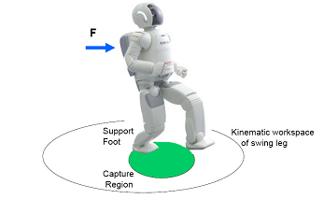
Contd…
When to take step: the robot is able to recover from the external force without taking step if a capture point is situated within the convex hull of the foot support area.

Slide 6
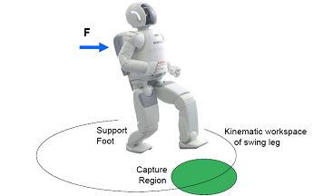
Contd…
Where to take step: if the base of support regains an intersection with the capture region after taking a step, robot is able to bring itself to stop.

Slide 7
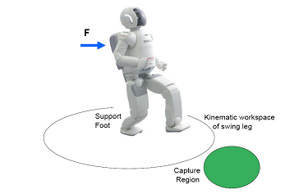
The problem
Failure: The humanoid will fail to recover from a push in one step if the capture region in its entirety lies outside the kinematic workspace of the swing foot. In this case the robot must take at least two steps in order to stop, if it can stop at all.
It is troublesome to obtain perfect motion like human gait when there is high Degree of Freedom and variable mechanical structure of a human body.

Slide 8
The Goal Of Paper
The goal of this paper is to search easy, lucid way for push recovery walking in humanoid robots.
So we collect the push data by pushing humanoid robot from behind and we train the system by applying K-Mean algorithm and using crouch as data.
Therefore we get a trained system which can analyse and work on any push recovery strategy.

Slide 9
Strategy
Before humanoid robot can react to a push it needs to be detected.
Through accelerometer we can sense the dynamic of bipedal robot.
From an accelerometer we can read the linear acceleration data, which can be integrated to obtain the velocity data.
After the push is detected, the controller needs to remove the excessive momentum induced by the push so that the robot may continue to walk steadily.
The approximate number of steps to recover is derived using the Linear Inverted Pendulum Model.
The Centre of Mass trajectory is generated using the ZMP preview controller.
The ZMP preview controller generates the COM trajectory based on the ZMP reference.

Slide 10
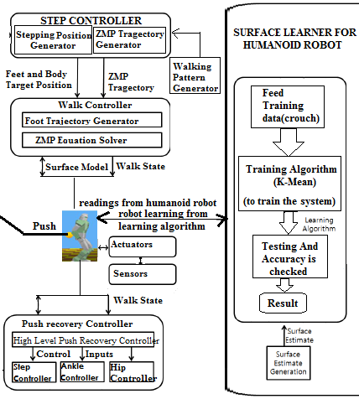
Proposed System Push recovery Controller

Slide 11
Push Recovery Controller
Push Recovery Controller
The work of Push Recovery Controller is to remove anxiety raised because of external disturbances or modelling error.
On uneven surface chances of perturbations is very high so PRC is more required.PRC can be categorised into 3 categories.
Types of Controller
1.) Ankle Controller: To keep COM within the base support the torque is applied on the ankle joints by the ankle controller.
2.) Step Controller: It controls the moves of the base to support in taking steps. With the relative target foot position a new step is inserted by overriding the step controller as x _{capture.}
3.) Hip Controller: It puts the angular acceleration of torso and limbs in use to create backward ground reaction force to pull COM back towards base support.

Slide 12
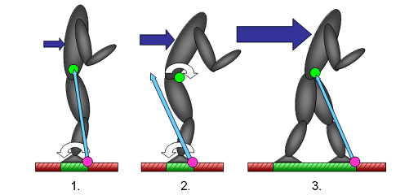
Contd…
Recovery Strategies :
Ankle Strategy
Hip Strategy
Stepping strategy

Slide 13
SOLUTION
In the context of this paper first stage involves to analyse the push recovery pattern.
Push recovery pattern can be analysed by collecting different data.
To find this pattern we need machine learning Technique.
In second stage we gather the data of humanoid robot by pushing it from a rigid ball from behind.
In third stage we calculate leg joint angles using inverse kinematics .

Slide 14
SOLUTION
In fourth stage we train the system using KNN classification and crouch data is tested on it.
In fifth stage we find out the push recovery strategy of humanoid robot on given training system to get better results or push recovery.
Then from the classifier we see whether the ZMP lie in safe region or not. If it doesn’t fall in safe region, we make the humanoid robot learn by modifying the algorithm and to sustain its walking.

Slide 15
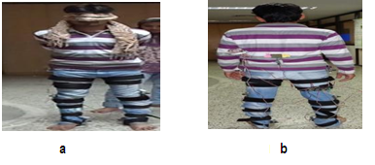
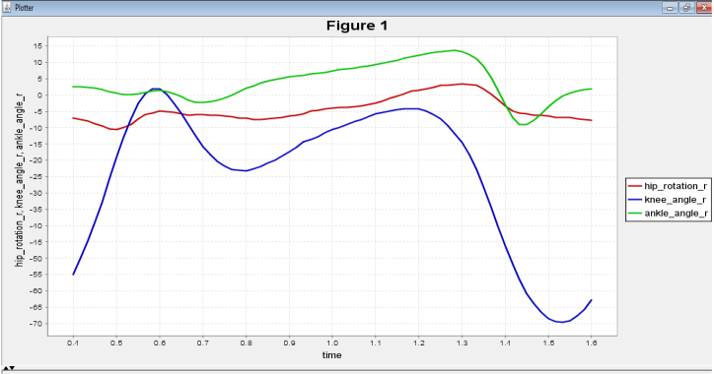
METHODOLOGY
TO GATHER DATA AND EXTRACT FEATURE
Data is captured using body sensor based Human Motion Capture Device (HMCD) and potentiometer.
Push data is also collected.

Slide 16
METHODOLOGY
TRAINING
The system is trained using K-mean algorithm which is an unsupervised classification technique.
Now K-mean algorithm is framed in order to classify the push data and then classification is done.
CLASSIFICATION
where classification is done on the data set.
It classifies the gait data where a set of data is already given.

Slide 17
METHODOLOGY
Then k-mean algorithm is framed in order to classify the trajectories of humanoid robot so as to find out which trajectories is safe push and which trajectory is not.
Now the classification data is compared with human gait data and then push recovery data can be trained accordingly to give better results.
Once this is done, now the trajectories of push data is classified in order to check whether the humanoid robot lies in safe region or the humanoid robot cannot recover from the push.

Slide 18
RESULTS
The simulation is done in WEBOTS, where the humanoid robot is equipped with accelerometer in the pelvic.
In the experiment, similar motion of the simulation is produced to intensify the push force by modifying the COM position.
We keep changing the pushing force and push data is analysed using classifier.
As the data is collected by humanoid robot it is passed through the proposed algorithm and it shows the learning pattern of push recovery.
When the classification of data is done the overall accuracy obtained is 60% .

Slide 19
CONCLUSION
When the push is applied then the performance of proposed system is best and its impact lies near COM.
As the pushes occur away from COM the angular momentum will be greater and the performance of system will degrade and it becomes difficult for humanoid robot to recover.
So the proposed method can be used to reduce anxiety up to large extend this approach can be used in the motion rules for humanoid robot walking and running.

Slide 20
Queries…

Slide 21
THANK YOU

Slide 22
r
.

Slide 23
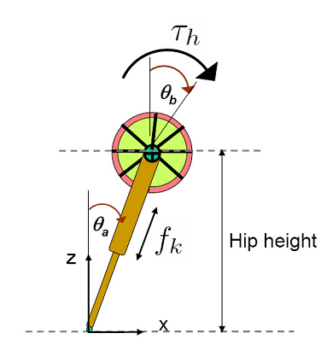
LITERATURE REVIEW
Linear Inverted Pendulum (LIP) with Fly Wheel model[1]:
This model included flywheel in LIP to add effect of generating angular momentum so as to implement lunging technique, the way humans do.

Slide 24
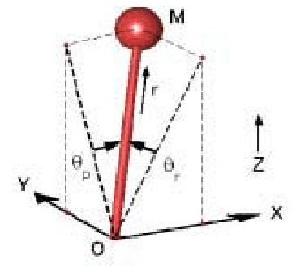
Contd…
3-D Linear Inverted Pendulum Model[2]:
This model was implemented with the approach of capturing the pelvis joint trajectory in sagittal and frontal plane.

Slide 25
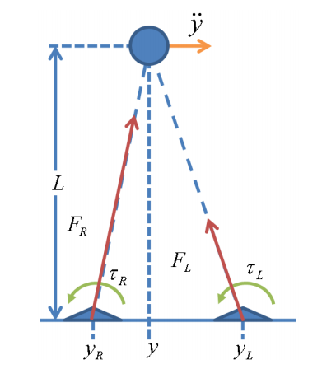
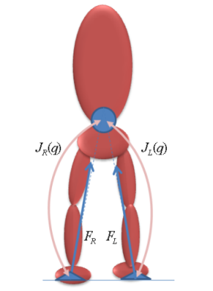
Contd…
Linear Inverted Biped Model (LIBM)[3]:
In this model , 2 LIPM’s were superimposed to imitate human structure , and revealed various concepts that LIPM could not capture.

Slide 26

Contd…
Concept of Orbital Energy[1]:
This equation represents a Spring-Mass system with unit-mass and negative-rate spring with a spring constant – (g/z₀). If E_{LIP} >0 then while moving to the foot, the centre of mass will pass over it, If E_{LIP} <0, then COM will move in reverse direction and If E_{LIP} =0, then COM will come to rest over the foot. Orbital Energy will remain constant irrespective of the changes in the co-ordinate axis.

Slide 27
Contd…
Concept of Centroidal Angular Momentum[1]:
This Fly wheel generates reverse torque which is similar to the Hip strategy humans use.

Slide 28
Contd…
Concept of LIBM[3]:
Reverse torques at each foot is applied to maintain stability that resembles Ankle strategy human use. This is very useful in recovering from the impact of small forces.

Slide 29
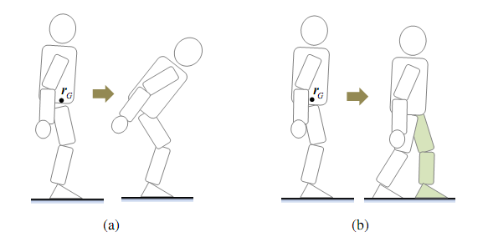
Concept of Linear and Angular momentum:[Ambarish sir]
This papers proposes a unified strategy of postural balance and reactive stepping integrated with momentum based controller. This enables us to control the angular momentum of humanoid.
This helps robot to maintain balance by making postural adjustments and hence avoid stepping.(a).

Slide 30
METHODOLOGY
STEP A: To make a model of linear inverted biped equivalent to HOAP-2 on WEBOT simulation tool. In this, we have taken parameters of HOAP-2 like mass, center of mass, height, length of leg etc.
STEP B: To calculate the D-H Parameters and Inverse forward Kinematics for the Model.
STEP C: To calculate the capture point and capture region for our model if external push/pull is applied to that.

Slide 31
Contd…
STEP D: To design a controller for our model and apply the calculated capture point stepping strategy in Webots simulation platform.
STEP E: Apply the strategy to HOAP-2 model in Webots Simulation, after getting satisfactory results in our model simulation.
STEP F: Finally apply the tested and sufficiently successful strategy, to HOAP-2 humanoid in our laboratory.

Slide 32
MODEL DESCRIPTION
Our model consists of a sphere surmounted on a disc. The disc is attached with two limbs.
Each limb is equipped with 3 servo motors at the hip , one at the knee and two at ankle.
The two servos that we have used at the foot do not play any role in moving the leg at any position but do keep the orientation of the feet almost parallel to the ground in swing phase and stance phase.

Slide 33
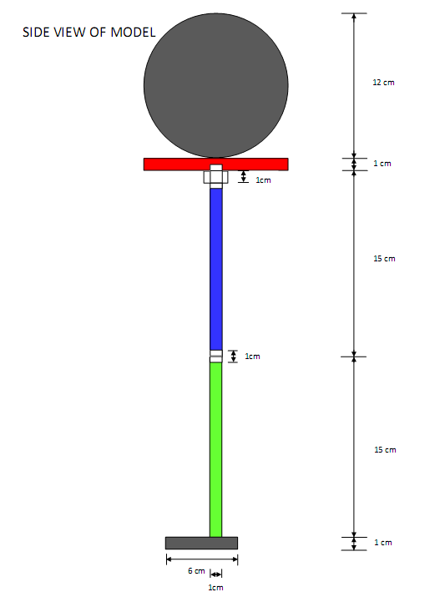
Contd…
SIDE VIEW OF THE MODEL

Slide 34
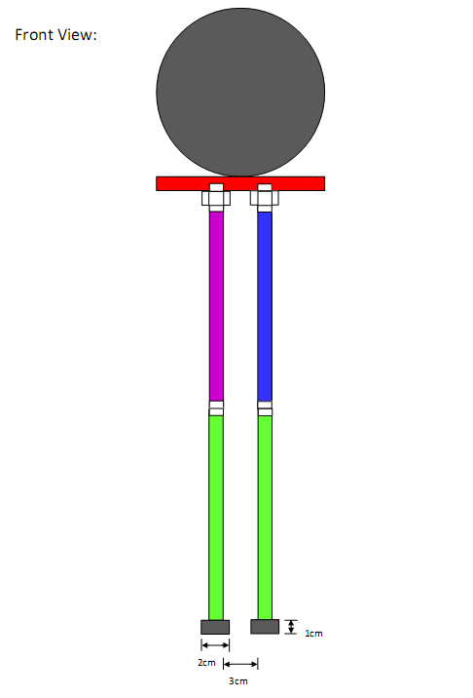
Contd…
FRONT VIEW OF THE MODEL

Slide 35
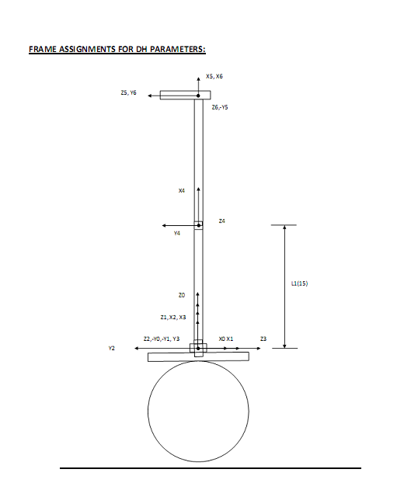
Contd…
Frame assignment diagram:

Slide 37
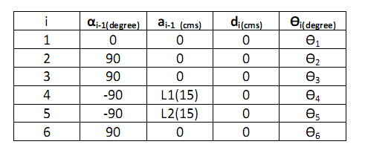
Contd…
D-H Parameters for the model:

Slide 38
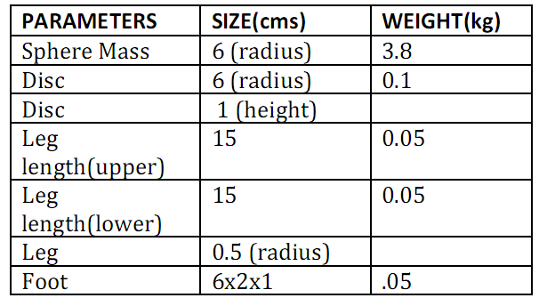
Contd…
Model dimensions and weight:

Slide 39
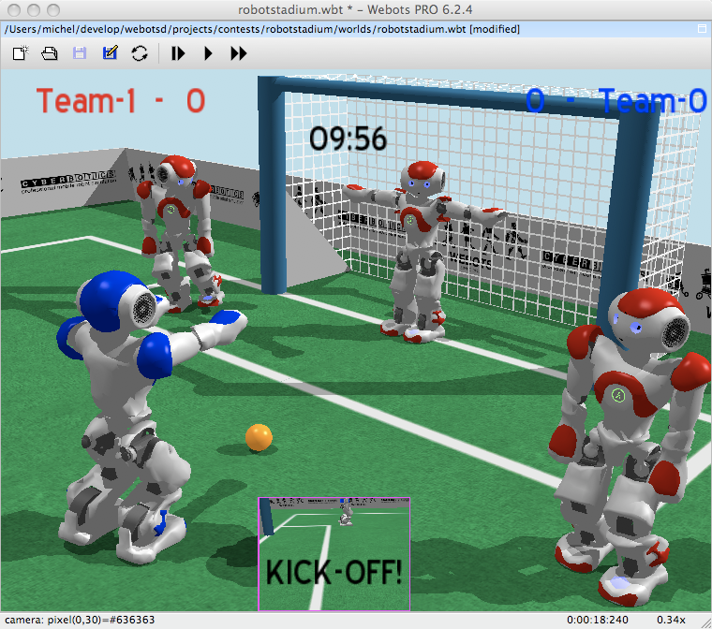
Contd…
DEMO IN WEBOTS

